Slide 1
Introduction to mass spectrometry (MS) – based proteomics and metabolomics
Tianwei Yu
Department of Biostatistics and Bioinformatics
Rollins School of Public Health
Emory University
August 31, 2019

Slide 2
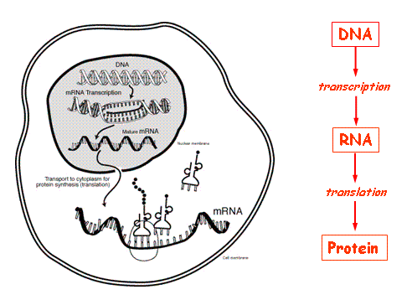
Background
High-throughput profiling of biological samples
Red line: central dogma
Blue line: interaction/ regulation
Metabolites
Environment
(Picture edited from http://www.ncbi.nlm.nih.gov/Class/MLACourse/Modules/MolBioReview/)
Genome: genotype, copy number, epigenetics ... | Transcriptome: mRNA expression levels, alternative splicing, microRNA, lincRNA …
Proteome: protein concentration, modification, interaction … | Metabolome: metabolite concentration, dynamics, environmental chemicals …

Slide 3
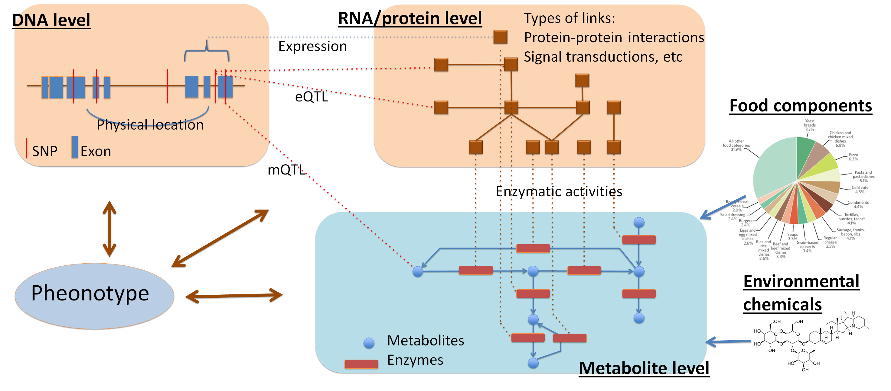
Background

Slide 4
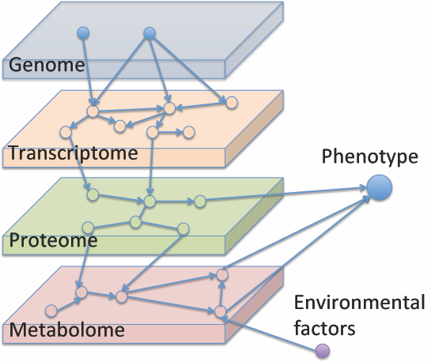
Background

Slide 5
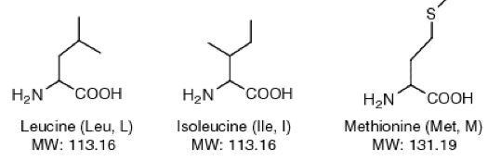
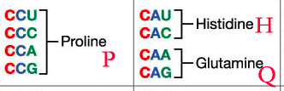
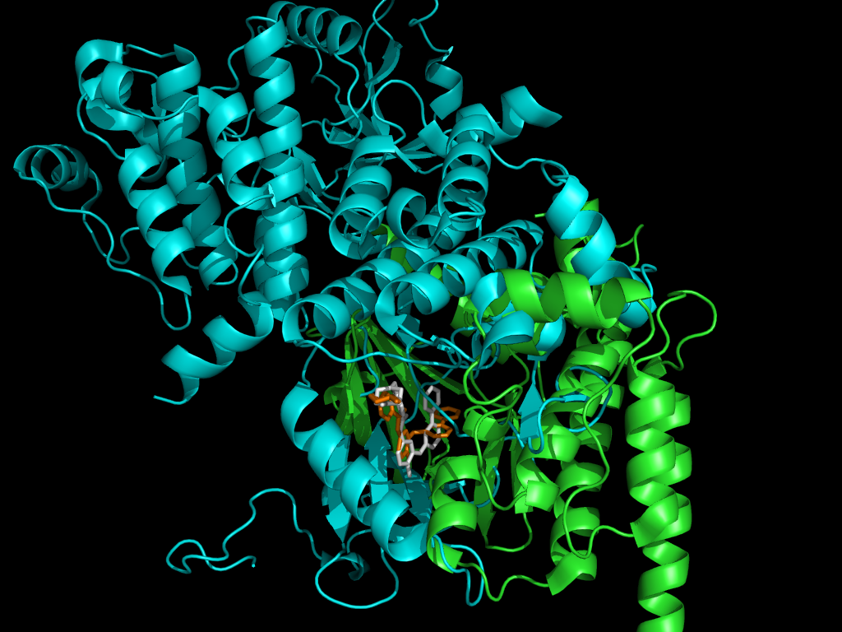
Background
http://matznerd.com/amino-acids/
Proteins:
Made of 20 amino acids
Sequence coded in DNA (Codon)
Folded into 3 dimensional structures
Carry out biological functions like
machines.
http://www.biogem.org/codon.jpg
http://compbio.cs.toronto.edu/ligalign/desc.html

Slide 6
Why Mass Spectrometry
Proteins/metabolites are harder to measure than DNA/RNA
- proteins are structured
- metabolites are small
- when in a complex mixture, neither can be identified/quantified using sequence-based methods
mRNA measurements by RNAseq and microarrays are in some sense proxy measurements of protein levels

Slide 7
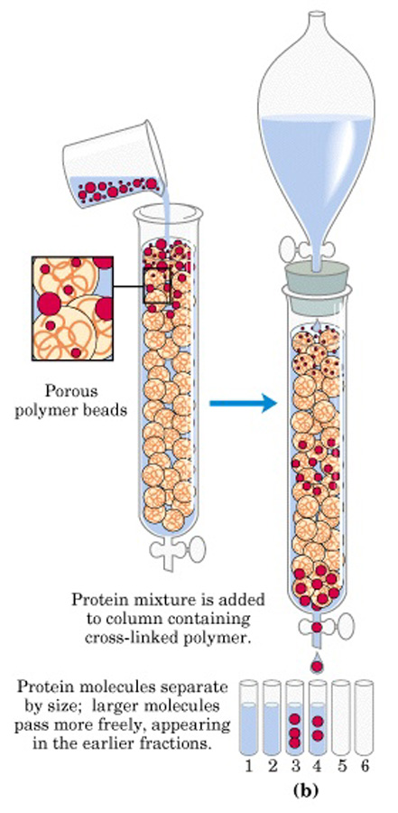
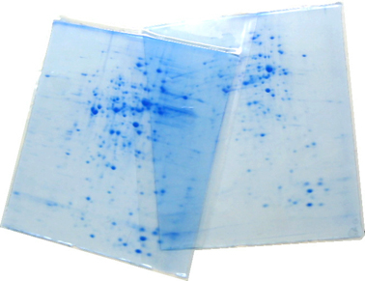
Why Mass Spectrometry
Proteins/metabolites could be separated according to their properties:
mass/size
hydrophilicity/hydrophobicity
binding to specific ligands
charge
… … … …
Using
Chromatography
Electrophoresis
… … … …
But these techniques
cannot identify what
is in the mixture
http://en.wikibooks.org/

Slide 8
Why Mass Spectrometry
Problems with separation techniques:
Reproducibility
Identification / Quantification
Inability to separate tens of thousands of iion species
Mass Spectrometry:
Measurements based on mass/charge ratio (m/z)
Highly accurate, highly reproducible measurements
Theoretical values easy to obtain → identification
Can study protein modifications (small ligands attached)

Slide 9
Principle of Mass Spectrometry (MS)
Proteins, Peptides, or small molecules
Mass Spectrometer
Mass/Charge
(m/z)
Ionization
Solution
Phase
Gas
Phase
Kindly provided by Dr. Junmin Peng

Slide 10
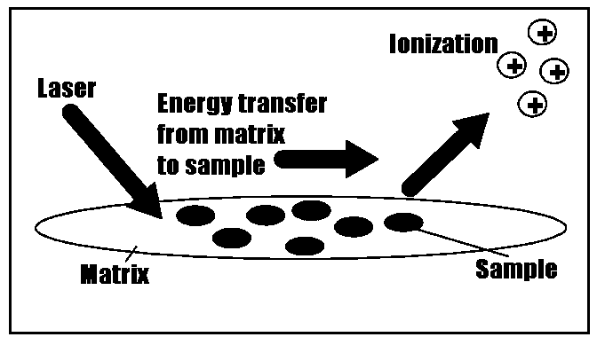
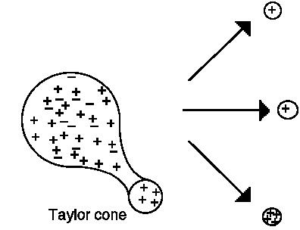
Mass Spectrometry --- getting ion from solution to gas phase
Picture provided by Prof. Junmin Peng (Emory)
Matrix assisted laser desorption ionization (MALDI)
Electrospray ionization (ESI)

Slide 11
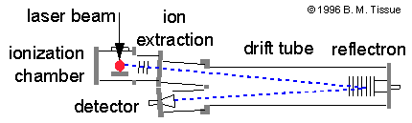
Mass Spectrometry --- finding m/z
Time-of-flight:
Putting a charged particle in an electric field, the time of flight is
k: a constant related to instrument characteristics

Slide 12
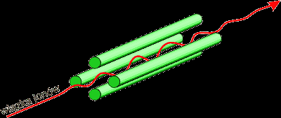
Mass Spectrometry --- finding m/z
Quadrupole:
Radio-frequency voltage applied to opposing pair of poles.
Only ions with a specific m/z can pass to the detector at each frequency.

Slide 13
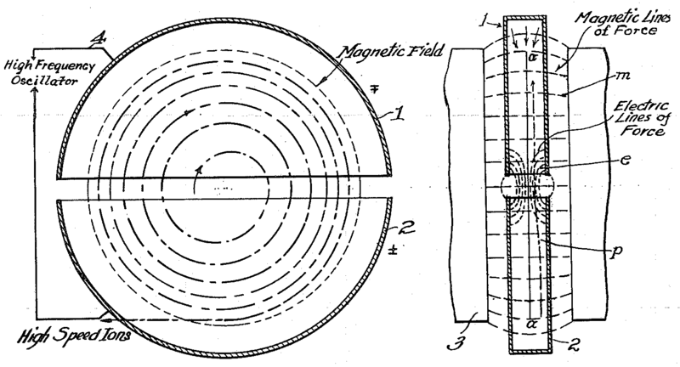
Mass Spectrometry --- finding m/z
Fourier transform MS.
Ions detected not by hitting a detector, but by passing by a detecting plate. Ions detected simultaneously.
Very high resolution.
m/z detected based on the frequency of the ion in the cyclotron.

Slide 14
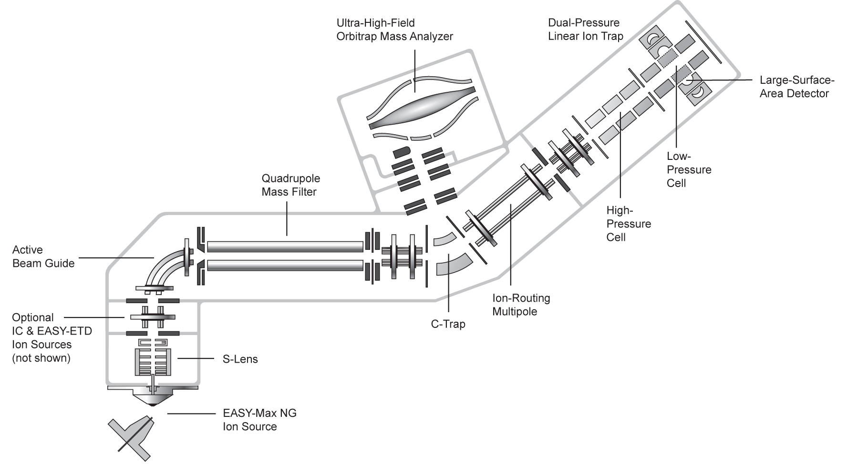
Mass Spectrometry --- finding m/z
High resolution Orbitrap Fusion

Slide 15
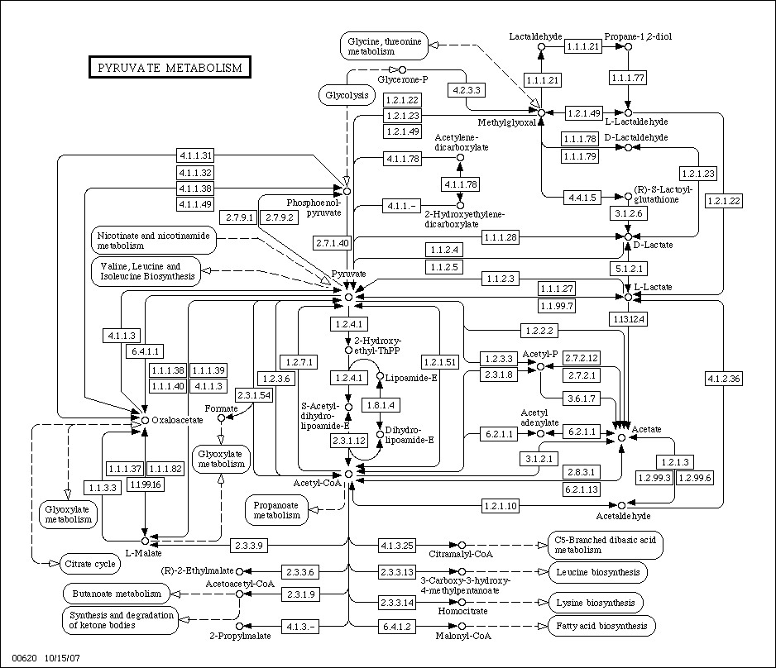
Metabolomics - Background
Why profile metabolites?
Enzymatic diseases directly influence metabolite concentrations
Detect disease-causing chemicals (e.g. pesticides in Parkinson’s) and their interactions with metabolic networks
Some medicines influence the metabolic pattern, or even directly interact with some metabolites.
Metabolic markers may exist for non-enzymatic diseases
Elucidate the regulations in the enzyme/metabolite network
(Picture from KEGG PATHWAY)

Slide 16
Metabolomics - Background
Thousands of metabolites exist in the biological system. Combined with other small molecules, high-throughput analysis of the system is a not an easy task.
 | # entries
Human Metabolome Database | 114,008 metabolites
DrugBank | 10256 drugs (3732 FDA approved small molecules)
FooDB | 28000 food components and food additives
T3DB | 3670 common toxins and environmental pollutants
Methods used to profile the metabolome:
Nuclear magnetic resonance (NMR)
Gas Chromatography - Mass Spectrometry (GC/MS)
Liquid Chromatography - Mass Spectrometry (LC/MS)
LC/MS/MS
…

Slide 17
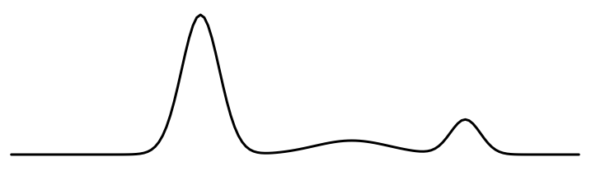
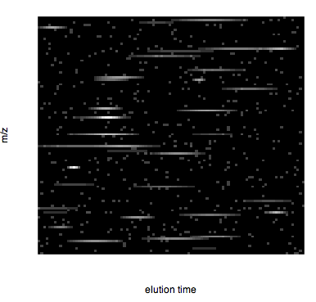
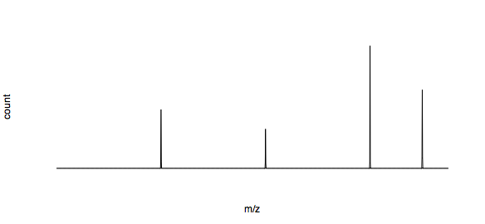
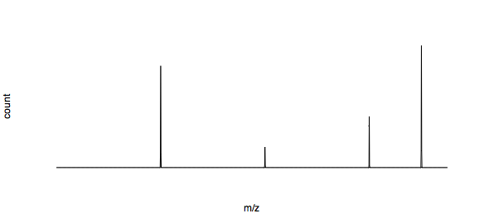
Metabolomics – LC/MS
Liquid chromotography
retention time
Take “slices” in retention time, send to MS
Mass-to-charge ratio (m/z)
retention time
Mass-to-charge ratio (m/z)

Slide 18
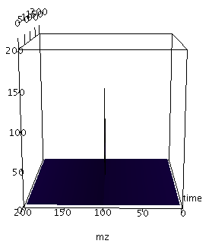
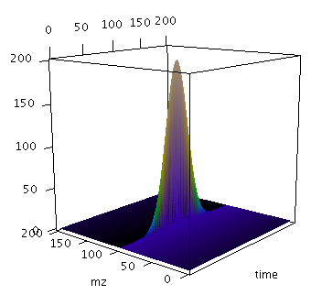
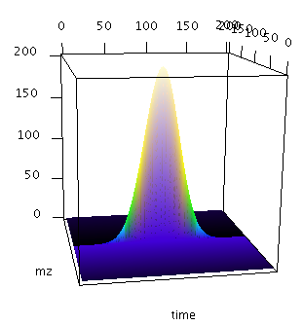
Metabolomics - LC/MS
An ideal peak should show a Gaussian curve in intensity along the retention time axis, while keeping constant in the m/z axis
Issues in LC/MS data processing:
•Background noise
•Chemical noise (ridges in spectra, ion suppression,…)
•Peak intensity (along retention time axis) deviate from Gaussian curve substantially (fronting, breaks, …)
•Slight m/z shift across MS spectra (not severe with newer machines)
•Retention time shift across LC/MS spectra
•Multiple charge status of a single metabolite
•Isotopes
……

Slide 19
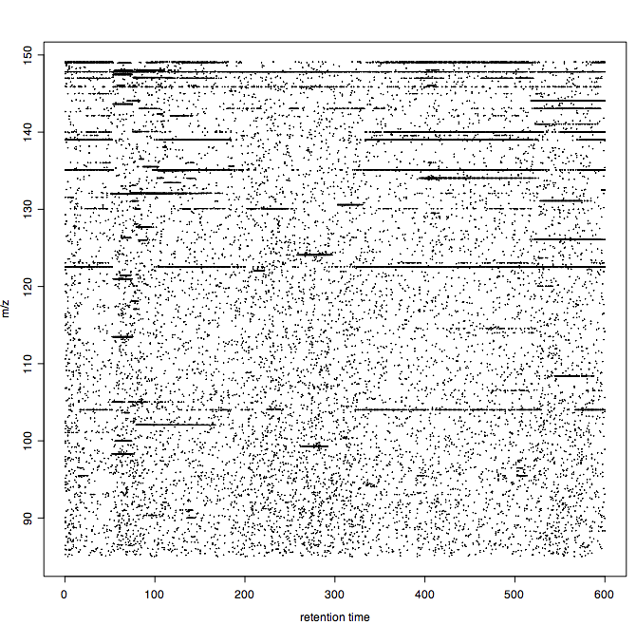
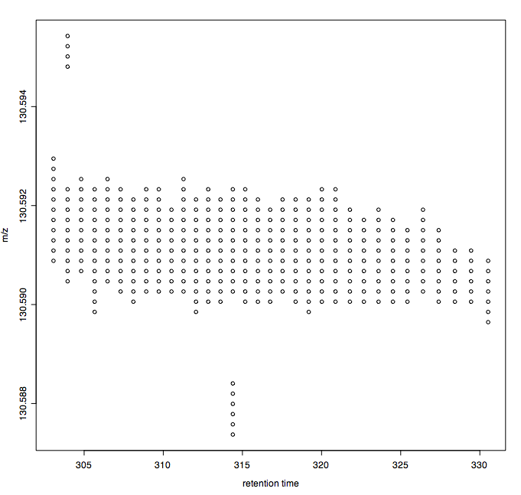
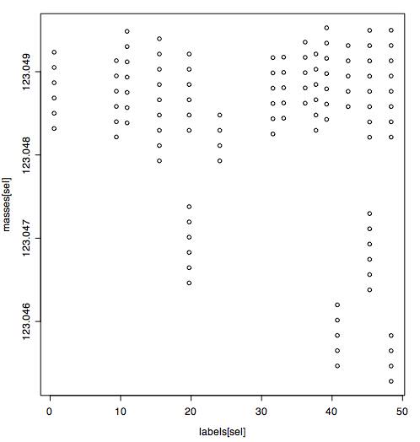
Metabolomics – LC/FTMS data

Slide 20
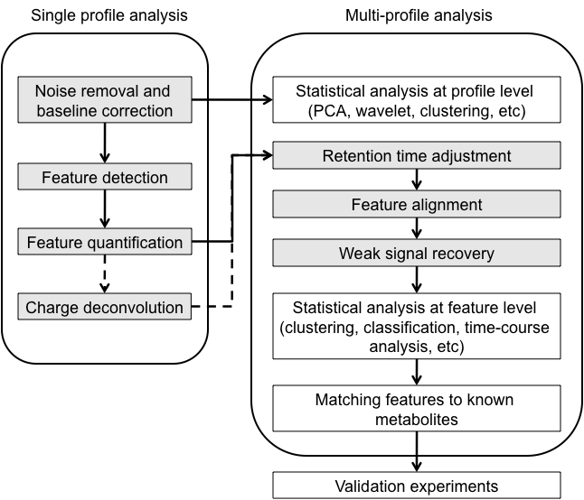
LC/MS data processing

Slide 21
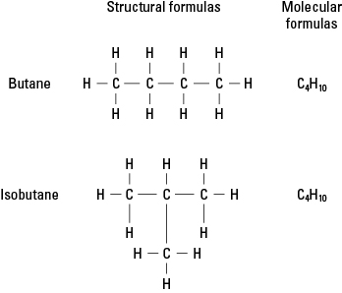
LC/MS data processing
How do we know which feature is which chemical?
We have three measurement on each feature:
m/z value, retention time, peak intensity
In high-resolution data, m/z value could almost pin-point the chemical composition. However some chemicals share same chemical composition.
A targeted MS/MS experiment may be necessary to differentiate between them.
http://www.cliffsnotes.com/sciences/chemistry/chemistry/organic-compounds/structural-formulas

Slide 22
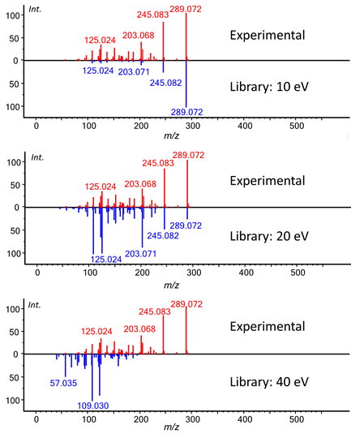
LC/MS data processing

Slide 23
Proteomics - How to identify a single protein by MS?
Mass/Charge
(m/z)
Mass
Digest into many peptides
Mass of many peptides
peptide mass fingerprinting (PMF)
Mass of many peptide fragments
By
Tandem Mass Spectrometry (MS/MS)
Kindly provided by Dr. Junmin Peng

Slide 24
Proteomics - How to identify a single protein by MS/MS?
Protein
digestion
MS spectrum
MS/MS spectrum
Theoretical
Spectrum
Database searching
Ionization
Fragmentation
Peptides
m/z
m/z
m/z
Peptide/protein
identification
LIFAGKQLEDGR
y ions
IFAGKQLEDGR:11
FAGKQLEDGR:10
AGKQLEDGR :9
GKQLEDGR :8
KQLEDGR :7
QLEDGR :6
LEDGR :5
EDGR :4
DGR :3
GR :2
R :1
b ions
1: L
2: LI
3: LIF
4: LIFA
5: LIFAG
6: LIFAGK
7: LIFAGKQ
8: LIFAGKQL
9: LIFAGKQLE
10:LIFAGKQLED
11:LIFAGKQLEDG
LI
F
A
G
K
Q
L
E
D
G
D
E
L
Q
K
G
A
F
Q
A
Kindly provided by Dr. Junmin Peng
m/z
200
400
600
800
1000
1200

Slide 25
Proteomics - Analysis of protein mixture by tandem MS (DDA)
Digestion
HPLC
Protein mixture
Peptides
0
10
20
30 min
MS
Database
Searching
LLTTIADAAK
SAGGNYVVFGEAK
EDDVEEAVQAADR
MS/MS
400 800 1200 1600
1 sequencing attempt per 0.5 sec.
3600 sequencing attempts in 30 min.
m/z
All peptide sequences
Identification of many proteins
Kindly provided by Dr. Junmin Peng

Slide 26
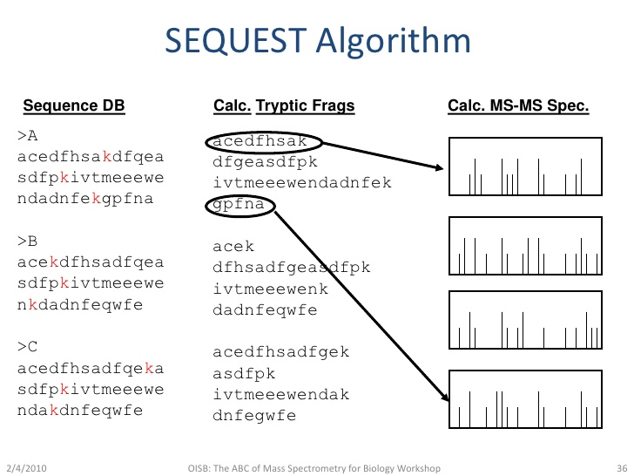
Michel Dumontier’s shared slides

Slide 27
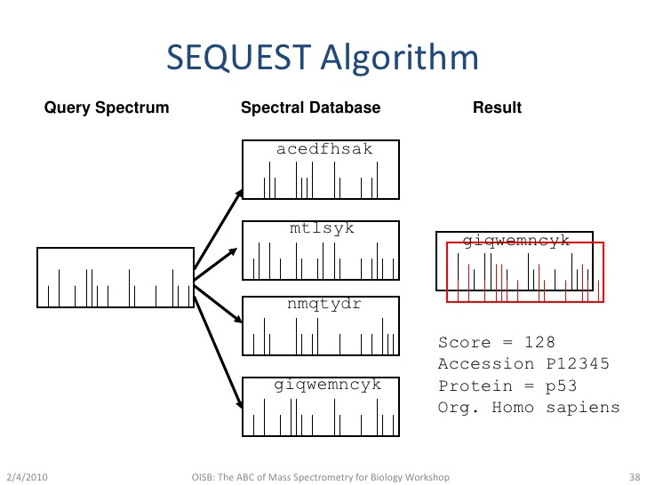
Michel Dumontier’s shared slides

Slide 28
Proteomics - Analysis of complex protein mixtures
Difficulty:
In a complex biological sample (cell, tissue, serum, … ), there are several thousand protein species – tens of thousands of peptides after digestion; signal from less-abundant species may be suppressed.
Solution:
Must reduce complexity to identify and quantify proteins.
Incorporate biochemical separation techniques:
LC-MS/MS
LC/LC-MS/MS
……
2D gel-MS/MS
2D gel/LC-MS/MS
Affinity column separation – LC-MS/MS
Separate proteins in multiple dimensions. Sacrifice speed.
Analyze a subset of proteins.
Sacrifice coverage.

Slide 29
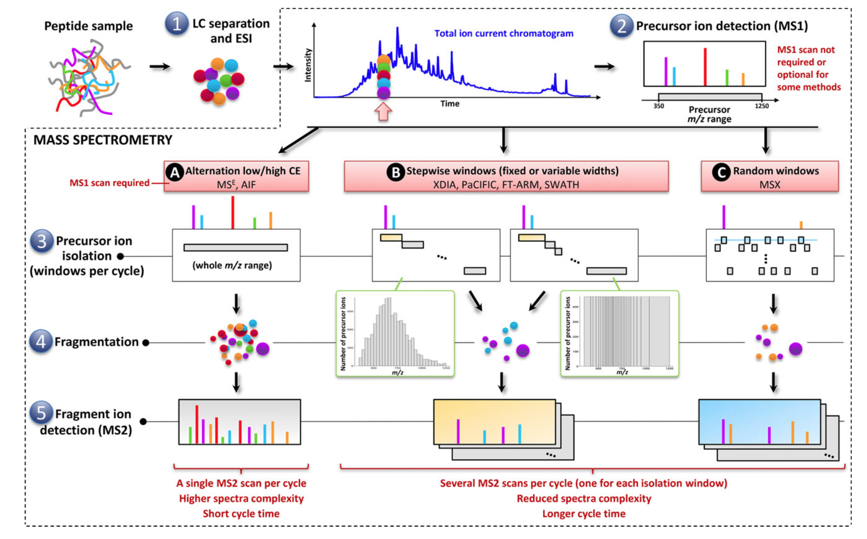
Proteomics – Data independent acquisition (DIA)
Proteomics 2015, 15, 964–980

Slide 30
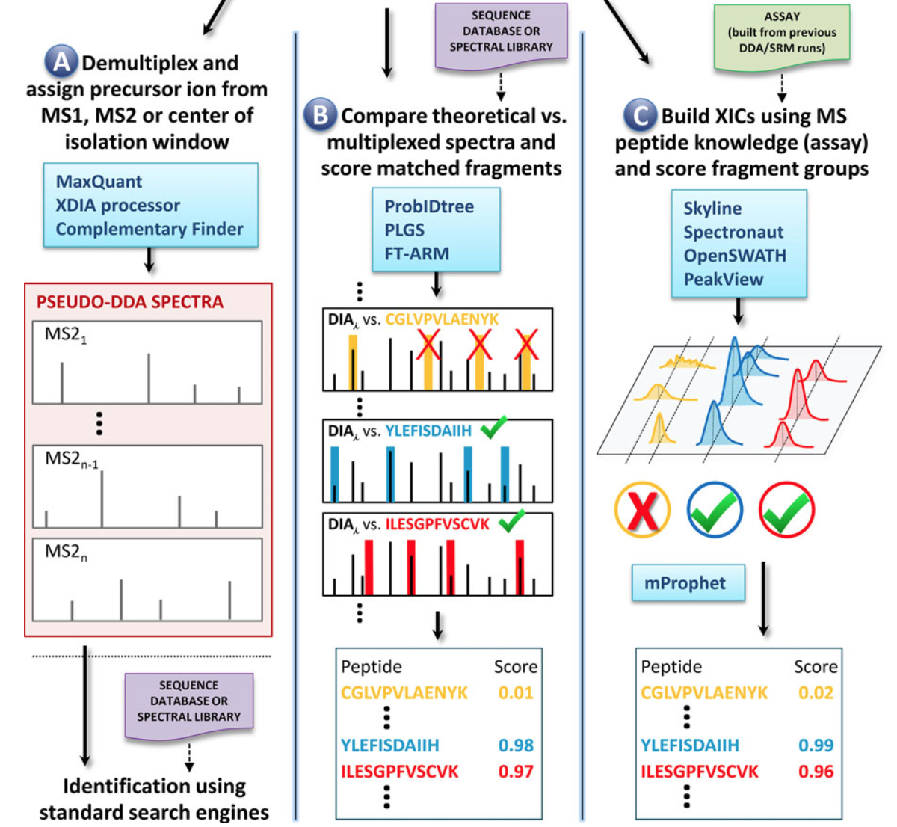
Proteomics – DIA
Proteomics 2015, 15, 964–980

Slide 31
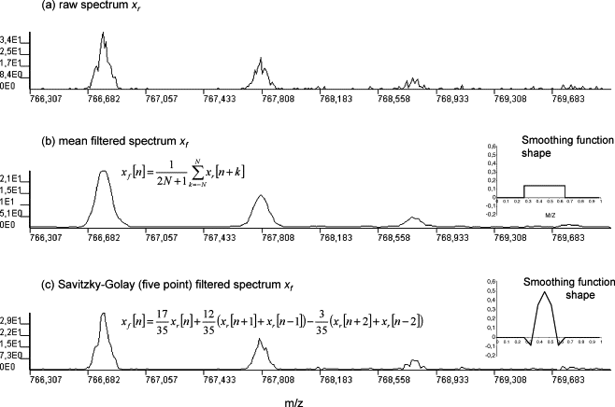
LC/MS – some example statistical methods
Reviewed by Katajamaa&Oresic (2007) J Chr. A 1158:318
Noise reduction disregarding the time axis:

Slide 32
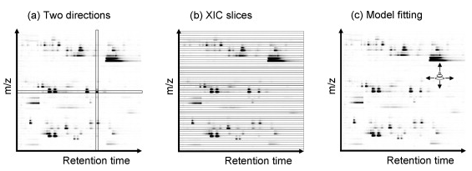
LC/MS – some example methods
Reviewed by Katajamaa&Oresic (2007) J Chr. A 1158:318
Peak Detection:

Slide 33
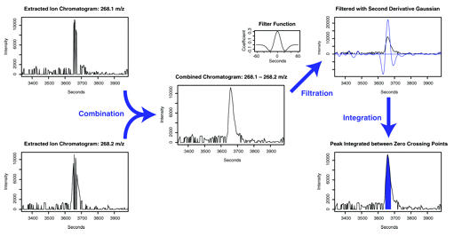
LC/MS – some example methods
Smith et.al. (2006) Analytical Chemistry. 78(3):779-87
Matched Gaussian filter along the time axis after EIC extraction.
coefficients are equal to a second-derivative Gaussian function.
The filtered chromatogram crosses the x-axis roughly at the peak inflection points.

Slide 34
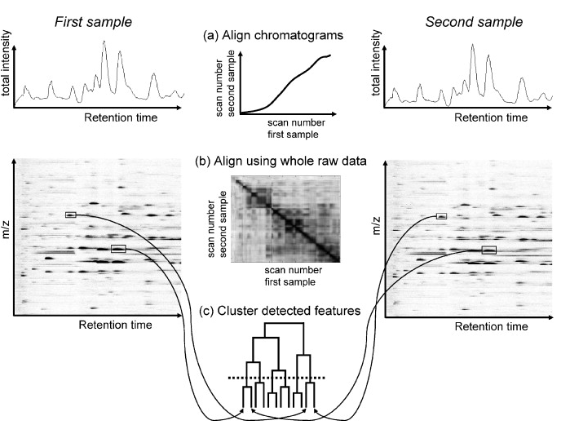
LC/MS – some example methods
Reviewed by Katajamaa&Oresic (2007) J Chr. A 1158:318
Retention time alignment:

Slide 35
LC/MS – some example methods
A model for asymetric peaks
Bi-Gaussian model:
Quantities used in peak location estimation:
At the summit,

Slide 36
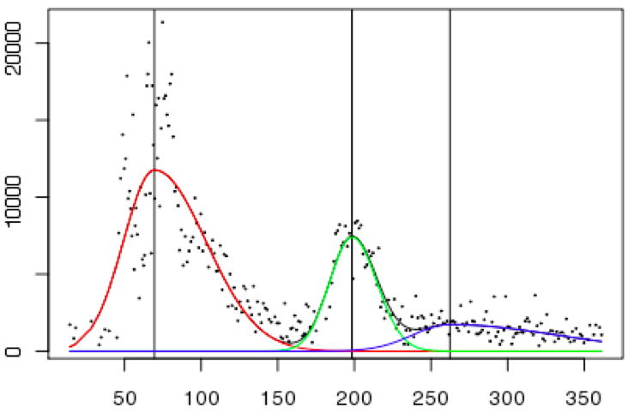
LC/MS – some example methods
Fitting a mixture of bi-Gaussian curves using EM-like algorithms

Slide 37
LC/MS – some example methods

Slide 38
Beyond pre-processing
Find features (genes/proteins/metabolites) significantly associated with a phenotype – “biomarkers”
Find biological pathways or sub-networks associated with a phenotype
Based on identified biomarkers, build predictive models for diagnosis, prognosis, or predict treatment response -> “personalized medicine”?
Identify feature-feature associations and previously unknown structures in the data
Find regulation patterns, both intrinsic and in relation to a phenotype

Slide 39
Beyond pre-processing
This is the common structure of microarray gene expression data from a simple cross-sectional case-control design.
Data from other high-throughput technology are often similar.
 | Control 1 | Control 2 | …… | Control 25 | Disease 1 | Disease 2 | …… | Disease 40
Gene 1 | 9.25 | 9.77 | …… | 9.4 | 8.58 | 5.62 | …… | 6.88
Gene 2 | 6.99 | 5.85 | …… | 5 | 5.14 | 5.43 | …… | 5.01
Gene 3 | 4.55 | 5.3 | …… | 4.73 | 3.66 | 4.27 | …… | 4.11
Gene 4 | 7.04 | 7.16 | …… | 6.47 | 6.79 | 6.87 | …… | 6.45
Gene 5 | 2.84 | 3.21 | …… | 3.2 | 3.06 | 3.26 | …… | 3.15
Gene 6 | 6.08 | 6.26 | …… | 7.19 | 6.12 | 5.93 | …… | 6.44
Gene 7 | 4 | 4.41 | …… | 4.22 | 4.42 | 4.09 | …… | 4.26
Gene 8 | 4.01 | 4.15 | …… | 3.45 | 3.77 | 3.55 | …… | 3.82
Gene 9 | 6.37 | 7.2 | …… | 8.14 | 5.13 | 7.06 | …… | 7.27
Gene 10 | 2.91 | 3.04 | …… | 3.03 | 2.83 | 3.86 | …… | 2.89
Gene 11 | 3.71 | 3.79 | …… | 3.39 | 5.15 | 6.23 | …… | 4.44
…… | …… | …… | …… | …… | …… | …… | …… | ……
Gene 25000 | 3.65 | 3.73 | …… | 3.8 | 3.87 | 3.76 | …… | 3.62

Slide 40
Workflow of feature selection
Raw data
Preprocessing, normalization,filtering …
Significance of every feature (FWER, FDR, …)
Feature-level expression in each sample
Other information (fold change, biological pathway
…)
Statistical testing/model fitting
Test statistic for every feature
Selected features
Compare to null distribution
Biological interpretation, … …
P-value for every feature

Slide 41
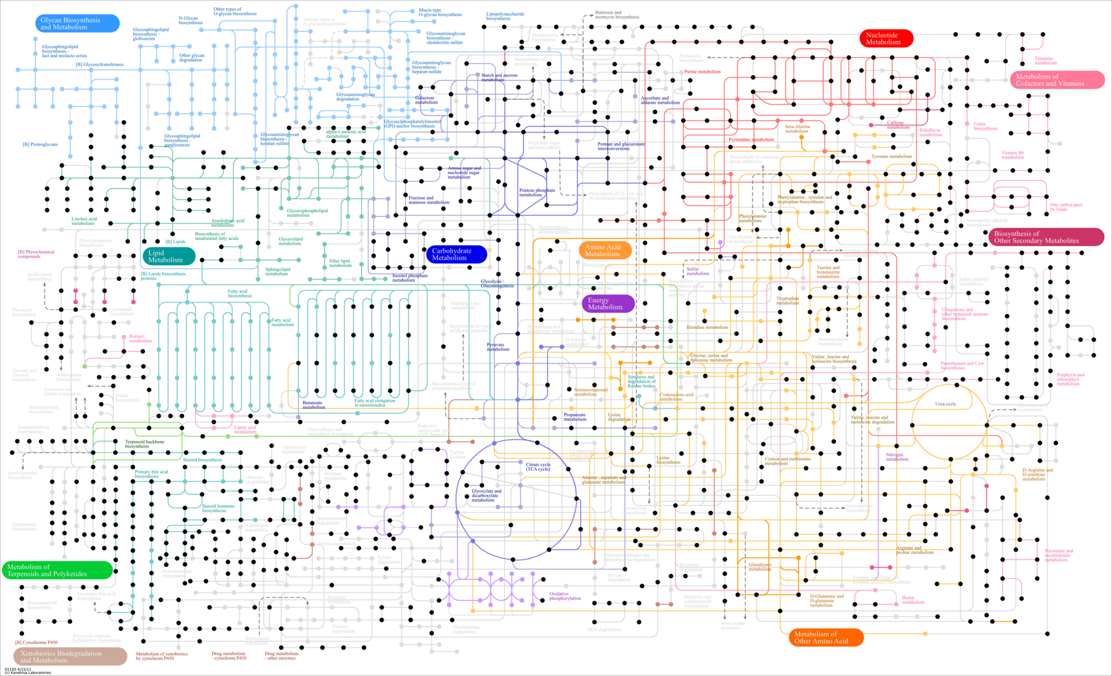
Genome-wide metabolic network

Slide 42
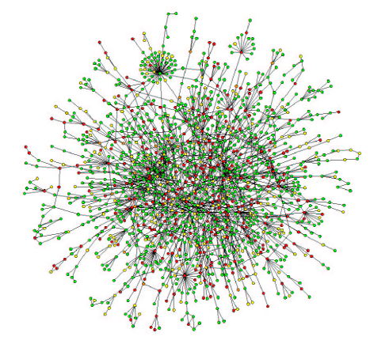
Protein interaction network
S. Wuchty, E. Ravasz and A.-L. Barabasi: The Architecture of Biological Networks

Slide 43
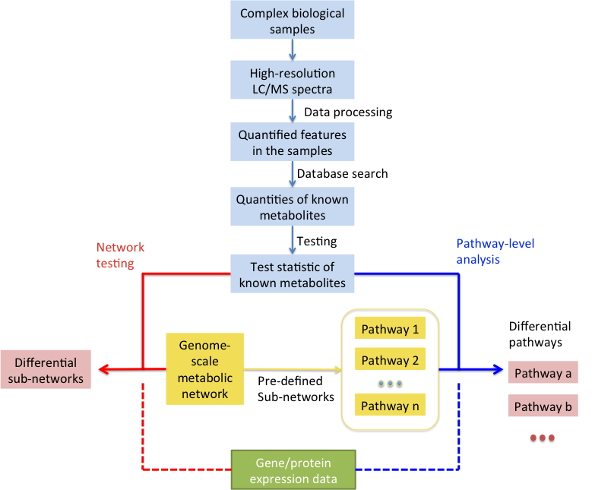
Knowledge-guided omics data analysis
Example: analyzing metabolomics data with genome-scale metabolic network.

Slide 44
Workflow of Gene Set Analysis
Raw data
Preprocessing, normalization,filtering …
Feature-level expression in each sample
Feature group information (biological pathway ……)
Statistical testing/model fitting
Group-level significance
Selected features from significant groups

Slide 45
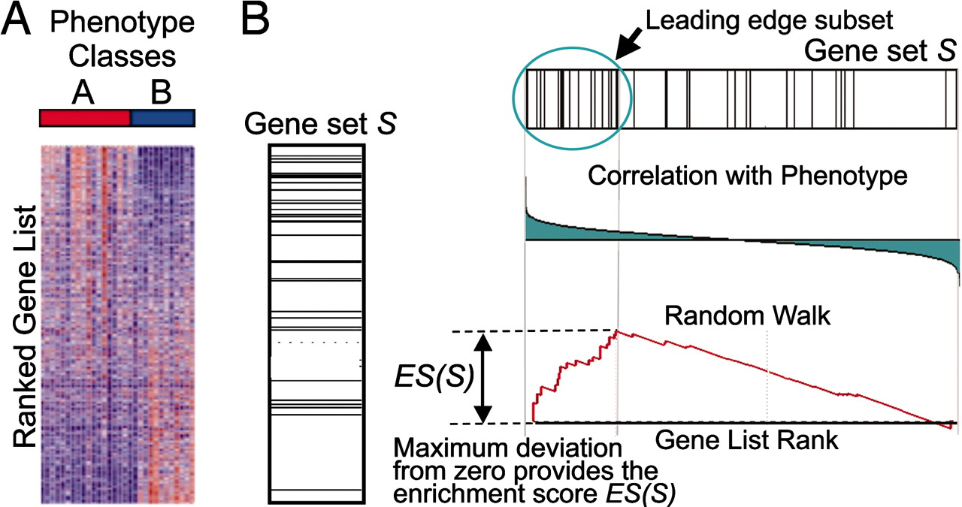
Knowledge-guided omics data analysis
An example: Selecting gene sets (pre-defined gene groups) associated with phenotype.
PNAS, vol. 102, no. 43, 15545–15550

Slide 46
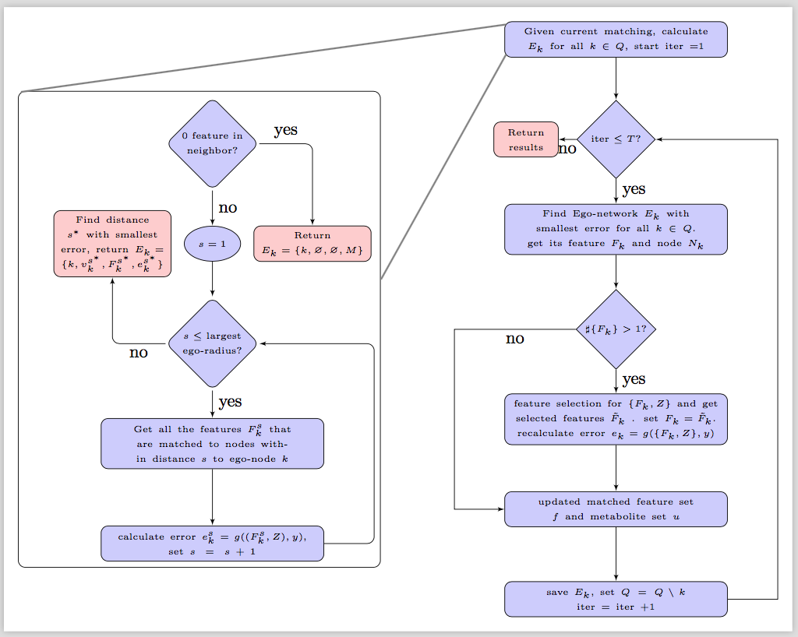
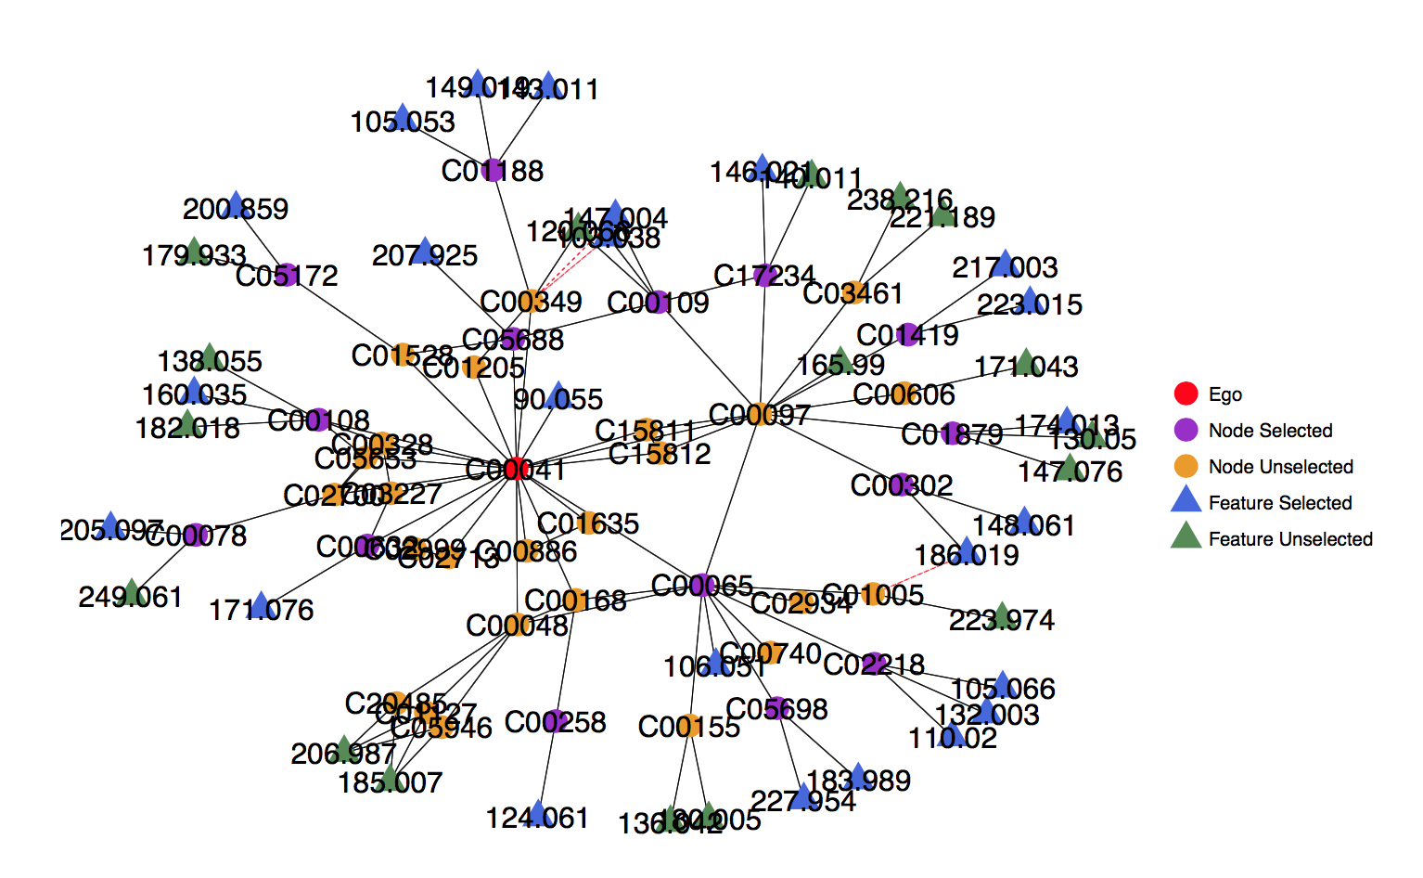
Knowledge-guided omics data analysis
An example: Selecting metabolic subnetworks associated with a pheonotype.

